Slide 1
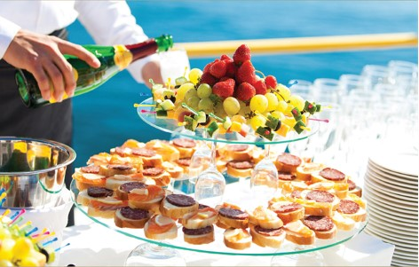
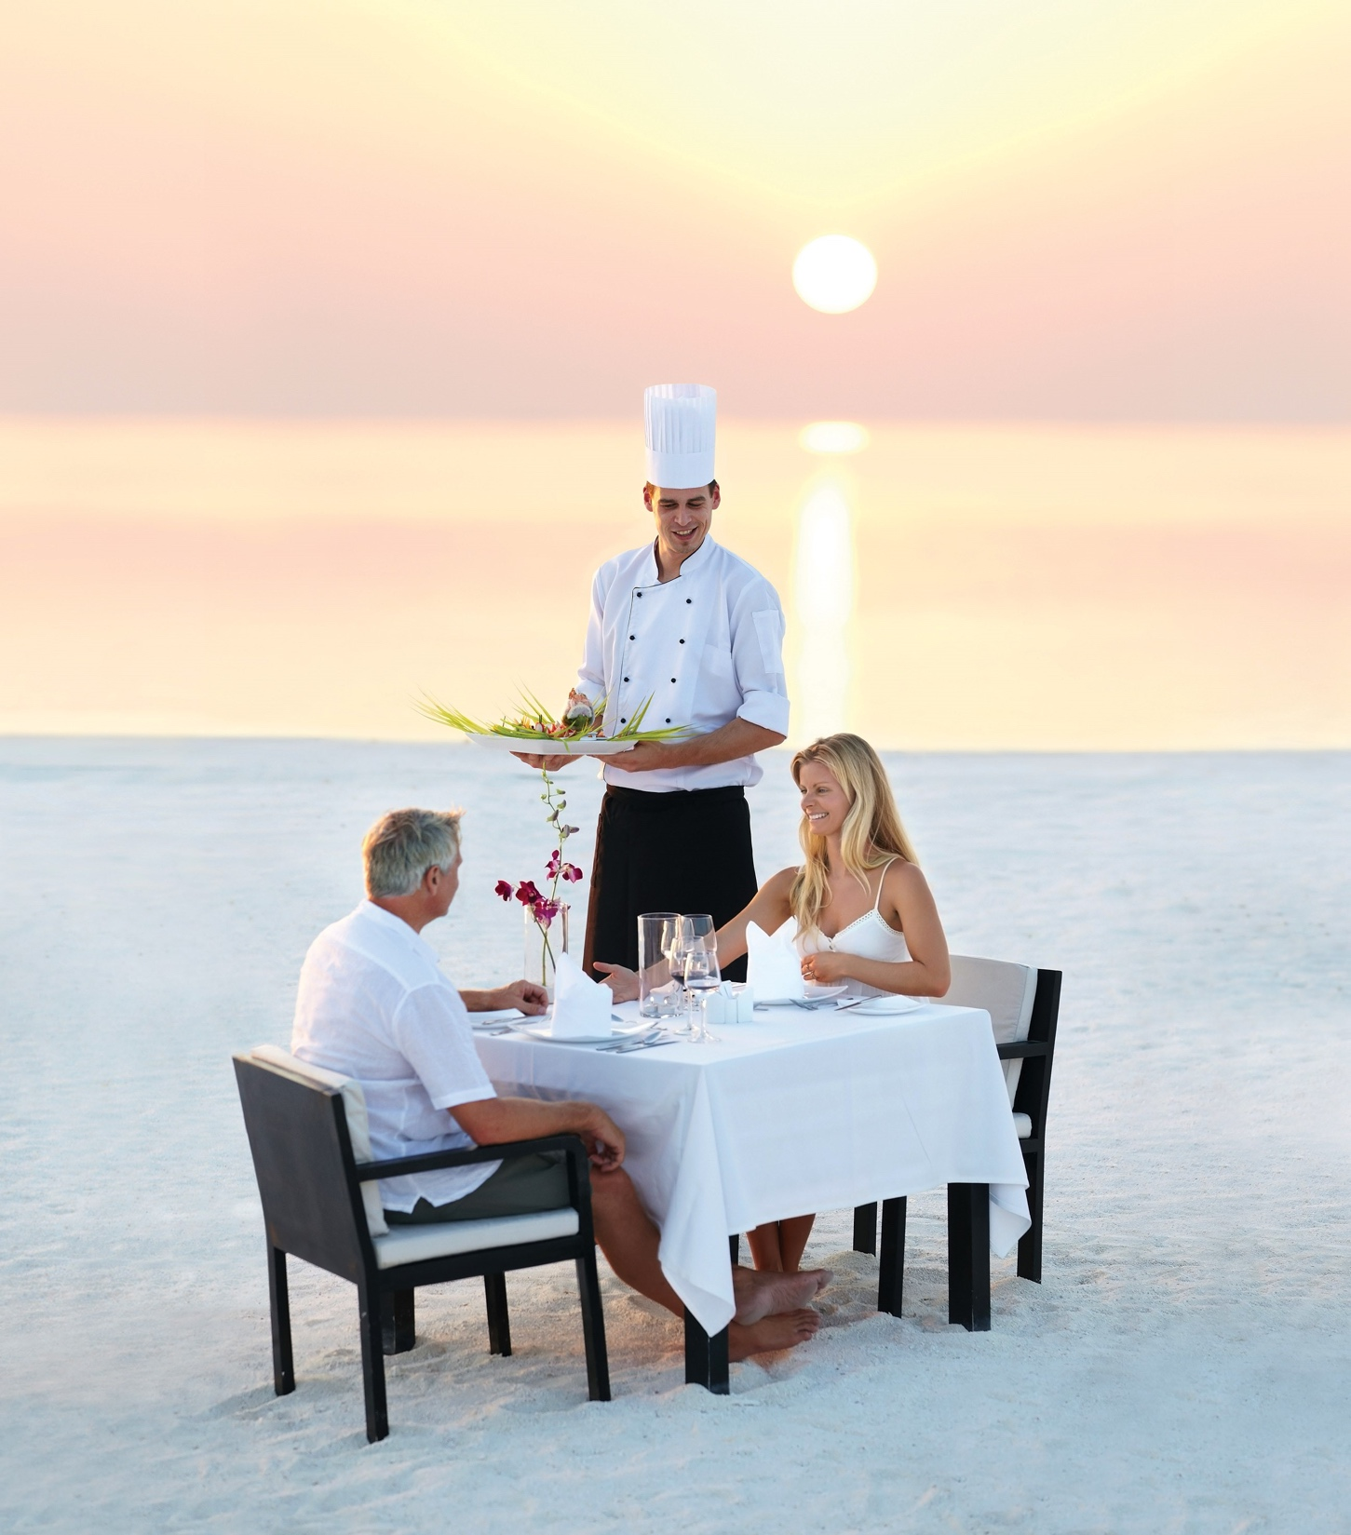

Chapter 10
The importance of service recovery
Introduction to customer service
© Hudson & Hudson. Customer Service for Hospitality & Tourism 3rd edn

Slide 2
Topics Covered
Definition of service recovery and recent studies
Service recovery paradox
The recovery process
Consequences of an effective recovery process
Recovery via social media
Guidelines for soliciting, tracking and handling complaints
Reasons and criteria for service guarantees
Service guarantee impacts

Slide 3
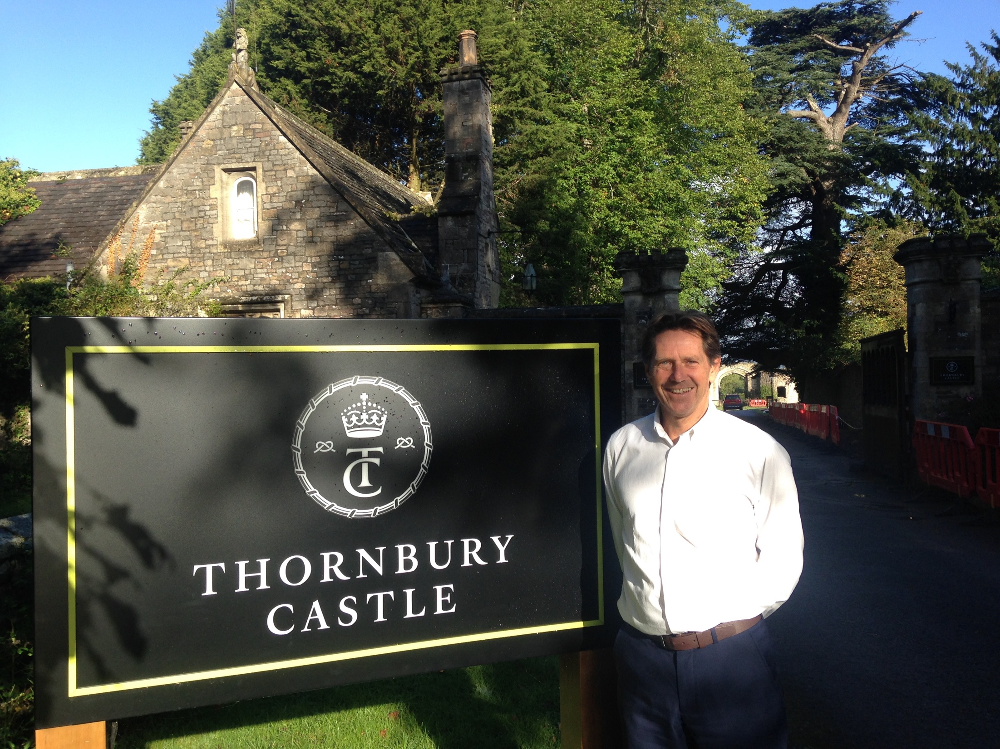
‘At Your Service’ Spotlight:
Solving problems for travelers
Fix it, plus one.
No ‘passing the buck’
  Positive feedback and word of mouth
Anticipating service problems
Service recovery training
  Case studies, role plays, letters of complaints
Solve immediate problem and ‘a bit extra’
Encourage guest feedback
  Determine what the customer values
  Determine future prevention strategies

Slide 4
Service recovery
The process by which a company attempts to rectify
a service delivery failure.
Studies inconclusive, findings contradictory
Tour operating sector
(Schoefer & Ennew, 2004; Smith & Bolton, 1998)
Hotel industry and service recovery
  Recovery, satisfaction and repeat patronage
  (Leong, Kim & Ham, 2002; Lewis & McCann, 2004;
  O’Neill & Mattila, 2004; Yavas et al., 2004)
Restaurant and fast-food sector
  Customer expectations and loyalty, perceptions of significance
  (Hoffman, Kelley & Rotalsky, 1995; Leong & Kim, 2002;
  Sundaram, Jurowski & Webster, 1997)

Slide 5
The service recovery paradox
Figure 10.1 (Source: Adapted from Schindlholzer, 2008)

Slide 6
Service recovery process
Apology
  Frames customer’s perceptions and paves the way to recovery
Urgent reinstatement
  Quick action to correct or remove problem
Empathy
  Employee understanding and responsiveness
Symbolic atonement
  Tangible evidence of organization’s willingness to take responsibility
Follow-up
  Evaluate recovery plan

Slide 7
The consequences of an effective recovery process
Service failures
  ‘Customer Complaint Iceberg’
  Damage to employee morale
Effective service recovery
  Impacts customer satisfaction
  Impacts perceptions of quality
  Impacts bottom-line performance
  Enhances customer loyalty
  Stimulates positive word of mouth

Slide 8
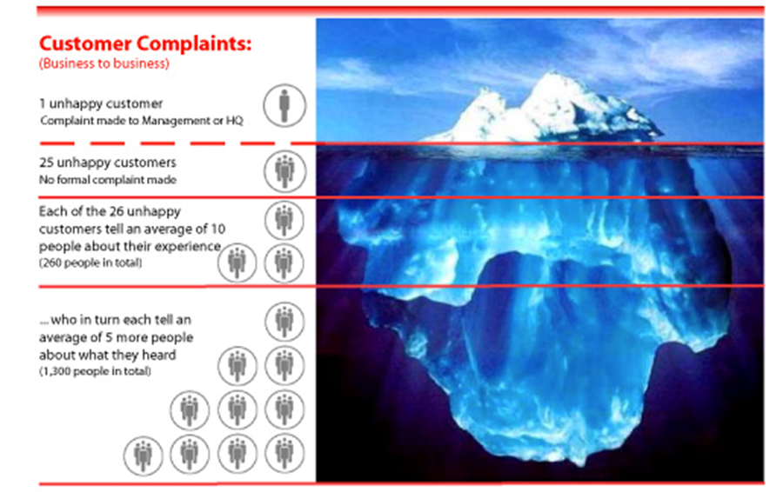
The Customer Complaint Iceberg
Figure 10.2 (Source: based on TARP, 1979)

Slide 9
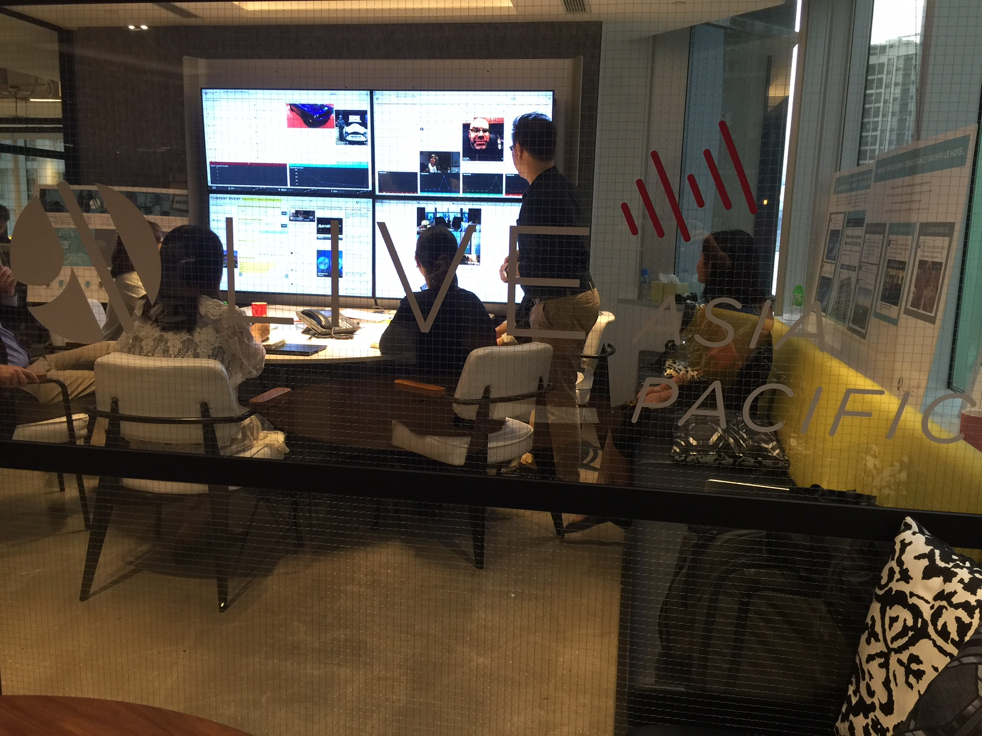
Service Snapshot:
Recovery via social media
In today’s very fast evolving marketplace you can’t talk so much but you have to listen more’
Organizations are increasingly using ‘social media listening’ to respond to consumer complaints (eg. Southwest, Marriott, G Adventures, Expedia).
Efficient means by which customers can be heard
Effective and timely problem solving
  Enhancing transparency of service culture
  Improves speed of resolution and recovery
Companies are ‘part of the conversation’

Slide 10
Soliciting, tracking and handling complaints
Make it easy for customers to complain
  Solicit complaints through multiple channels
Respond quickly to complaints
Employee education and empowerment
  Strategic and financial value of complaints
  Appropriate coping and problem-solving skills
Complaints viewed as operational problems, strategic opportunities
Make complaints and complainers visible
Align quality measures, performance reviews, compensation
Reward complainers
Stop calling them ‘complainers’!

Slide 11
Reasons and criteria for service guarantees
Table 10.1 (Source: based on Hart, 1990; Zeithaml et al, 2007)

Slide 12
Service guarantee impacts on marketing and operations
Figure 10.3 (Kandampully and Duddy, 2001, pp. 36)

Slide 13
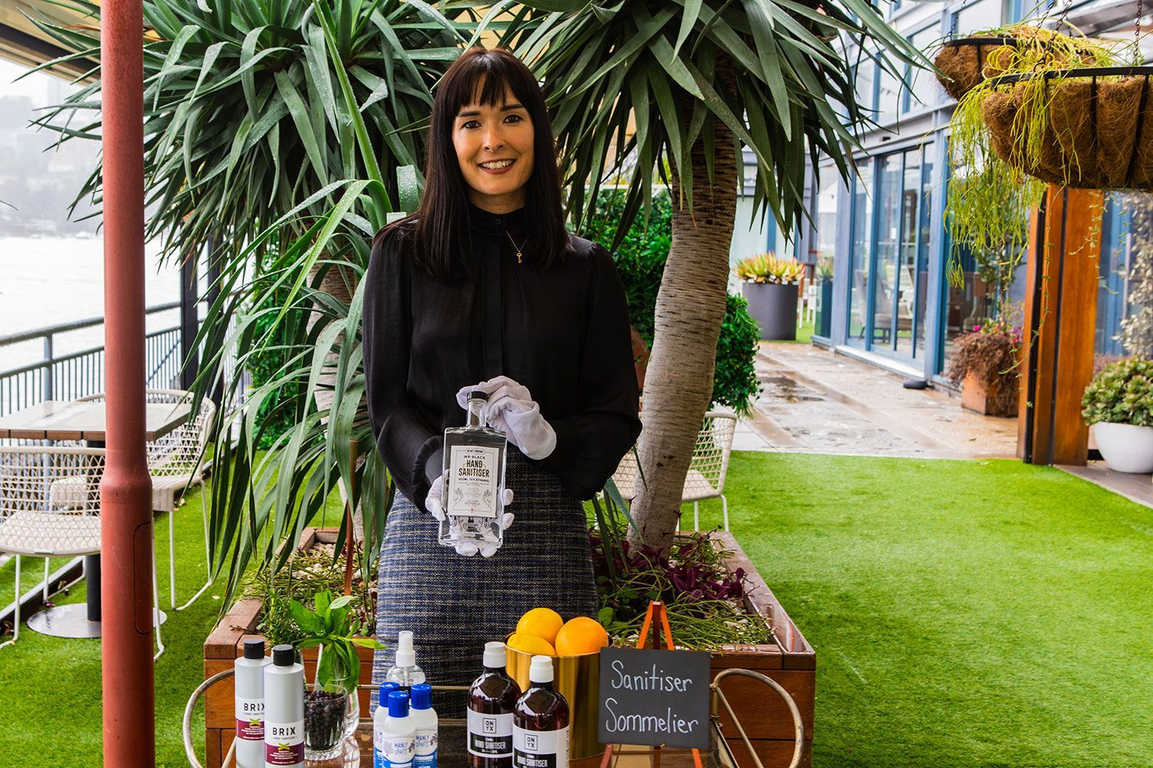
Case Study:
Adaptability key to pandemic recovery for Australia’s tourism industry
Tourism in Australia was one of the sectors hardest hit by the COVID-19 pandemic.
Tourism Australia, the government agency responsible for promoting tourism in Australia, had to change strategy quite quickly
Operators had to adapt to cater for the domestic market.
“2020 has demonstrated that both large and small travel agencies, OTAs, wholesalers, tour operators and even suppliers, have needed to pivot, adapt and rearrange their businesses rapidly.”
Some, like Ovolo Hotels, made changes in response to the pandemic that had a focus on customer interaction.
Others – like Pier One Sydney Harbour offered something entirely new – access to a hand sanitizer sommelier on arrival at its Gantry Restaurant.

